Slide 1
DECARBONIZATION
Paul McCown
P.E., CEM, CxA, LEED AP
Ashrae – EAST TN CHAPTER JANUARY 18, 2023

Slide 2
Agenda
Decarbonization:
What is it
Who started it
Why is it important
What can we do about it

Slide 3
WHAT IS IT?
Decarbonization is the global effort to reduce greenhouse gas emissions in all production areas, the most notable being carbon dioxide from burning fossil fuels.
ASHRAE TASK FORCE FOR BUILDING DECARBONIZATION (modified)

Slide 4
WHY IS IT IMPORANT?
Decarbonization is essential to reducing Anthropogenic Global Climate Change, according to the Intergovernmental Panel on Climate Change (IPCC) and other global scientific and intergovernmental agencies.

Slide 5
WHY IS IT IMPORTANT?

Slide 6
WHO STARTED IT?
Decarbonization

Slide 7
Who started it?

Slide 8
brief history of climate change

Slide 9
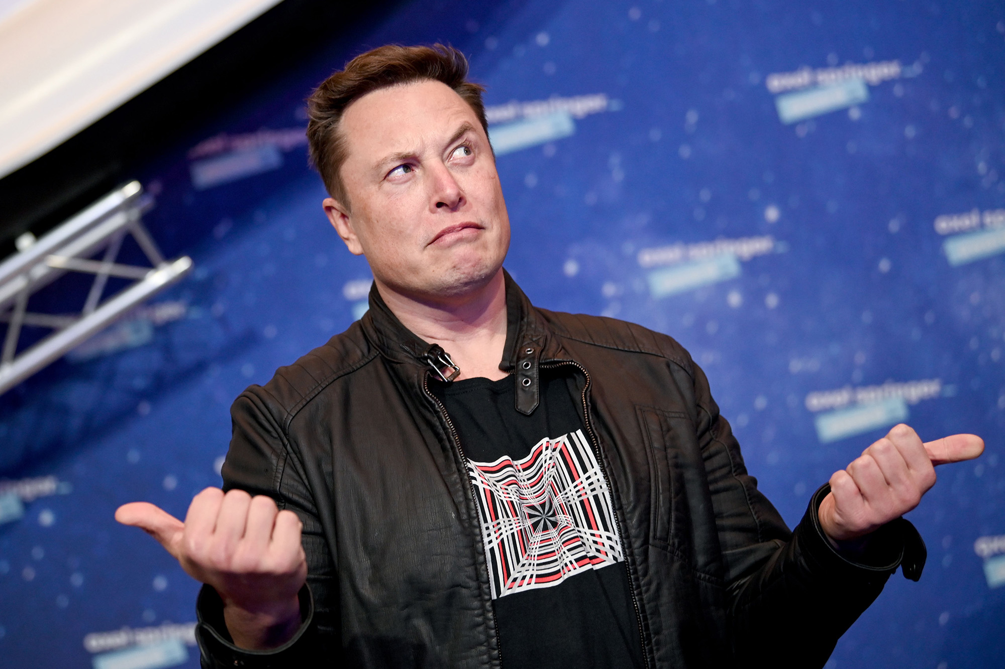
WHAT CAN WE DO about it?

Slide 10
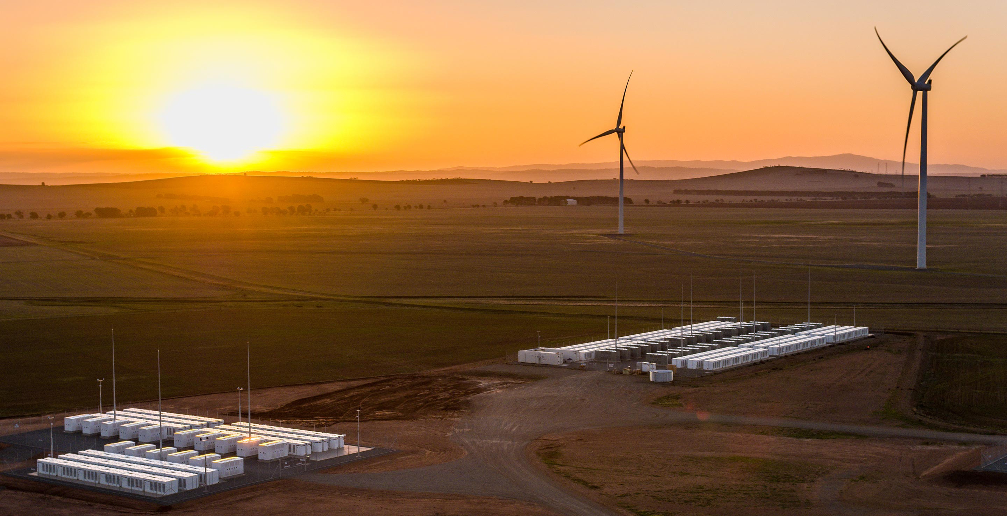
WHAT CAN WE DO?
C.a.f.e. standards?

Slide 11
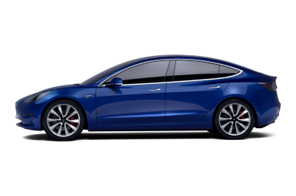
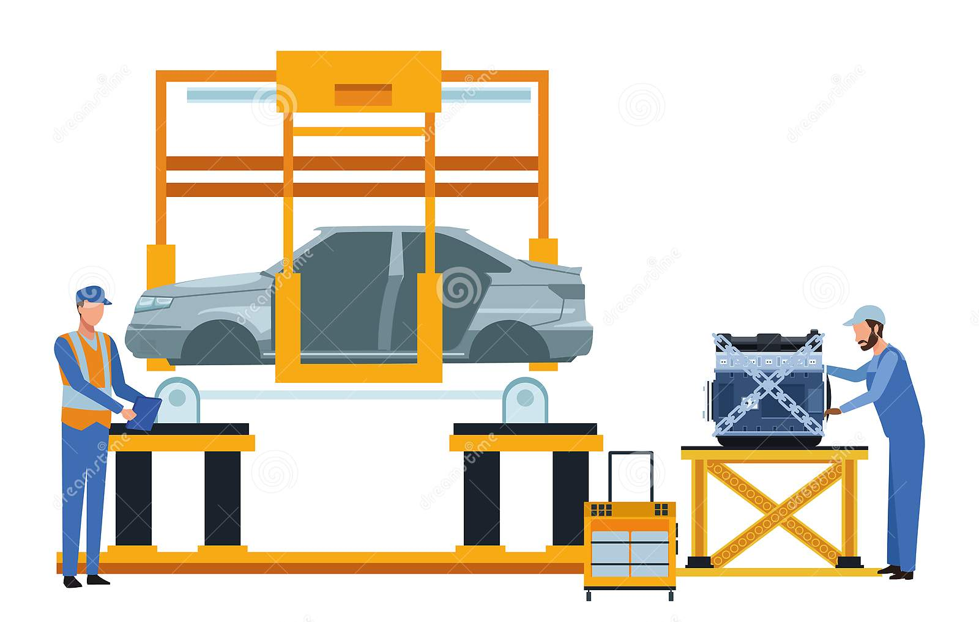
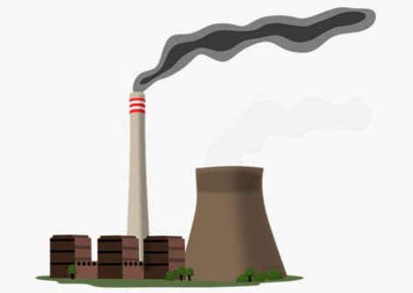
zev

Slide 12
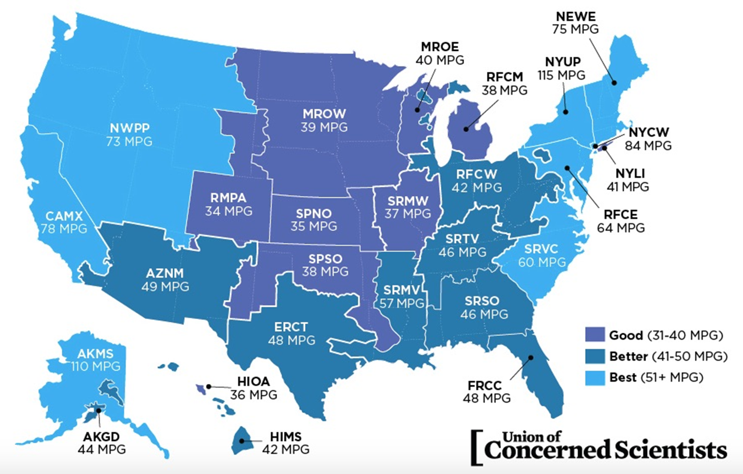

Slide 13
WHAT CAN WE DO?
Carbon cap and trade - explained

Slide 14
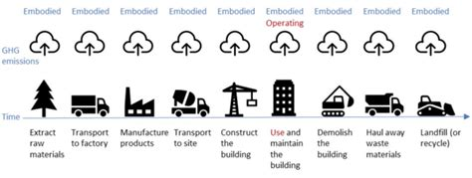
Embodied carbon

Slide 15
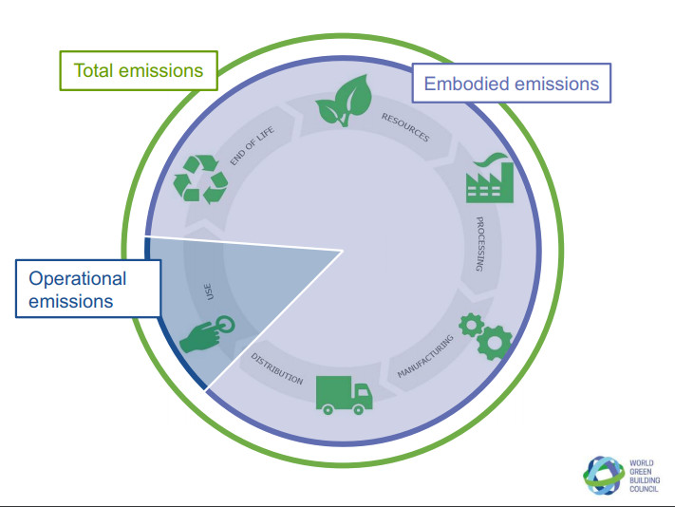
Embodied carbon

Slide 16
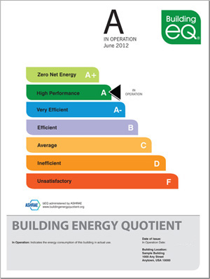
what is a net-zero building?
ASHRAE 90.1 COST
CBECS
CBECS
Commercial Building Energy Consumption Survey

Slide 17
WHAT CAN WE DO?
Decarbonization in buildings

Slide 18
What if we thought of buildings like trees?

Slide 19
WHAT CAN WE DO?
subsidies

Slide 20
WHAT CAN WE DO?
Public policy

Slide 21
What is Electrification?
Inflation reduction act of 2022

Slide 22
WHAT CAN WE DO?
Decarbonization
In our own lives

Slide 24
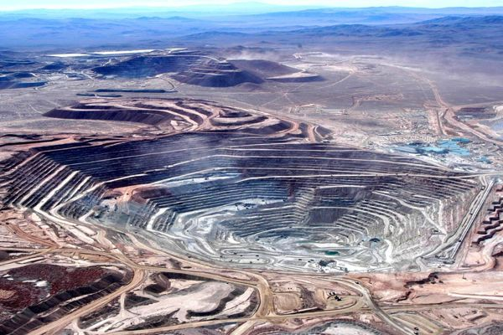
WHAT CAN WE DO? - batteries
lI - ion
niMh

Slide 25
WHAT CAN WE DO?

Slide 26
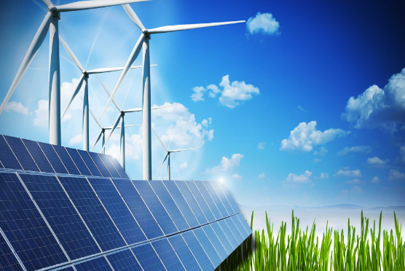
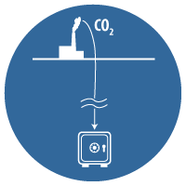
WHAT is coming?
More subsidies

Slide 27
When?
www.ashrae.org
www.tesla.com
www.cleanenergytransition.org
www.economist.com/climate-change
www.neom.com
www.energy.gov
www.globalcarbonproject.org
www.ipcc.ch
www.uscusa.org
www.protonpower.com
www.ariescleantech.com
www.whokilledtheelectriccar.com

Slide 28
Let us come together, and Be better… do better… live better… thank you!

